Slide 1


Zomato Recommendation System
BY - Project Guide-
Mr.Sameer Mujawar Mrs.Priti Take
Mr.Abhishek Pawar Group ID- 11

Slide 2
Introduction
Recommendation Systems are a type of information filtering systems as they improve the quality of search results and provides items that are more relevant to the search item or are related to the search history of the user.
There are three types of recommendation systems:-
Demographic Filtering- They offer generalized recommendations to every user
Content Based Filtering- They suggest similar items based on a particular item.
Collaborative Filtering- This system matches persons with similar interests and provides recommendations based on this matching
Here we will be using Content Based Filtering

Slide 3
How does Recommendation system work?
Specifically the Content-Based Filtering uses only information about the description and attributes of the items users has previously consumed to model user's preferences.
These algorithms try to recommend items that are similar to those that a user liked in the past (or is examining in the present).
In particular, various candidate items are compared with items previously rated by the user and the best-matching items are recommended.

Slide 4
Dataset used-
The dataset used for this project contains data from various restaurants across india, there are around 57000 rows and 17 columns.
The columns included in this data set are address,name,online_order,book_table,rate,votes,phone,location,rest_type,dish_liked,cuisines,approx_cost(for two people),menu_item,City

Slide 5
Data Processing
Loading the dataset: Load the data and import the libraries.
Data Cleaning:
Deleting redundant columns.
Renaming the columns.
Dropping duplicates.
Cleaning individual columns.
Remove the NaN values from the dataset

Slide 6
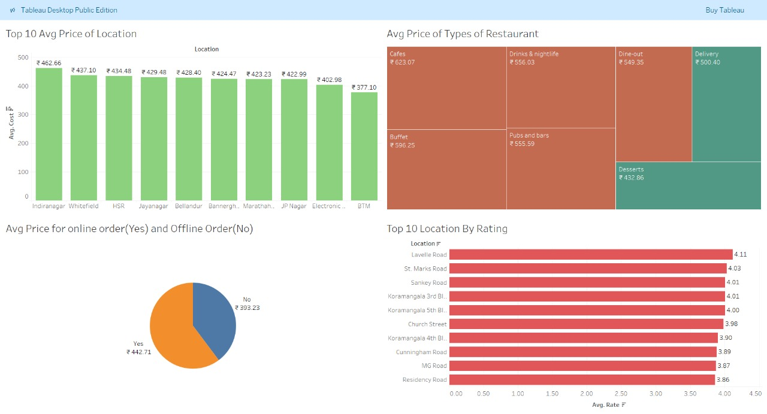
EDA

Slide 7
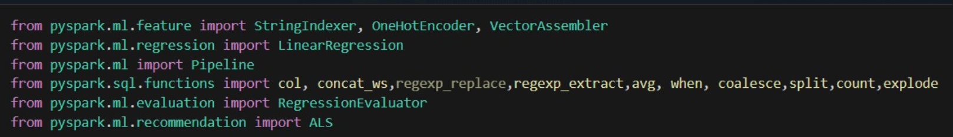
Recommendation System
Libraries used-

Slide 8
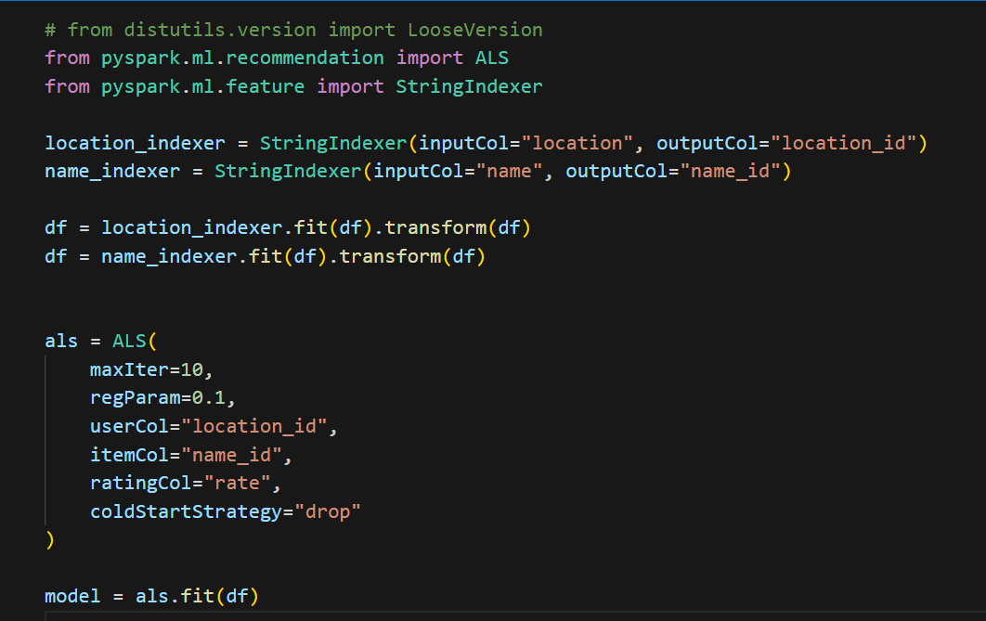
Recommendation System

Slide 9
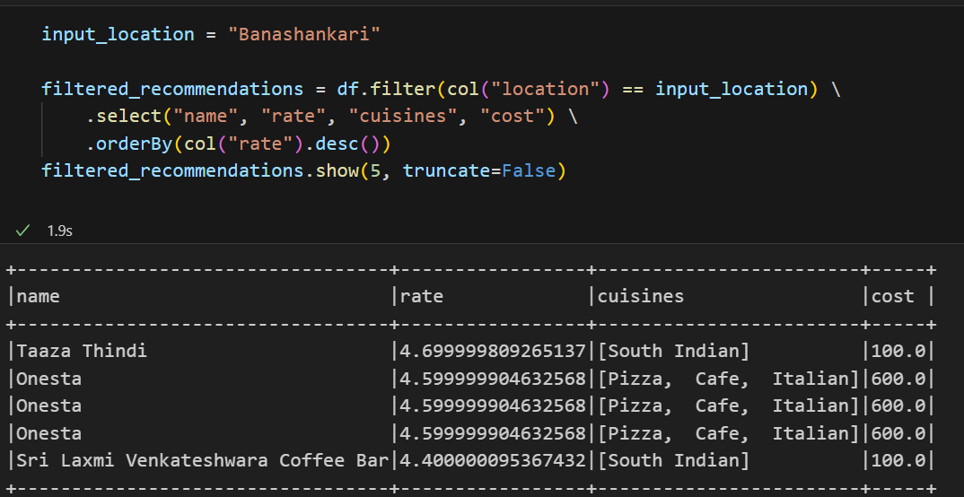
Output

Slide 10
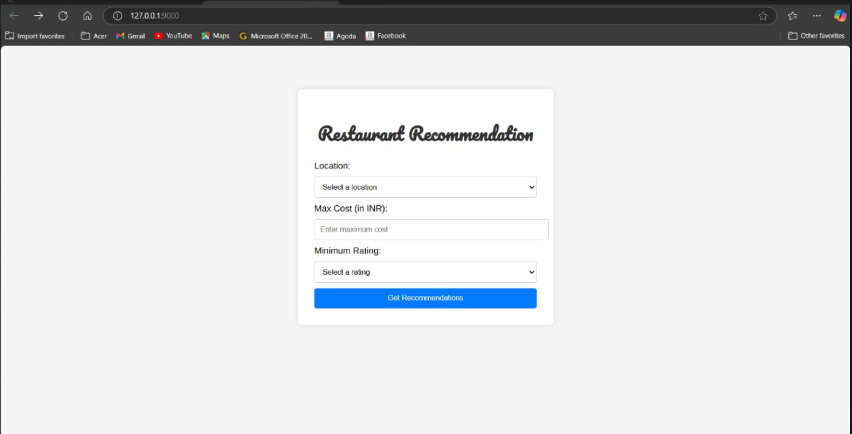
Deployment

Slide 11
Conclusion
By using a dataset of restaurant attributes such as location, cuisine, rating, and cost, the model provides personalized suggestions based on user preferences.
The recommendation system helps users discover top-rated restaurants in their selected location, while the cost prediction model estimates dining expenses, making it useful for budget-conscious diners.
Future improvements could include real-time data updates, user reviews analysis, and deep learning-based recommendations to enhance accuracy and personalization.
This system is a valuable tool for food enthusiasts, restaurant aggregators, and food delivery platforms, helping users make informed dining choices efficiently.

